Slide 1

Computer Vision Representation and Description
School of Software, SJTU

Slide 2
Representation and Description
Images and segmented regions must be represented and described in a form suitable for further processing.
The representations and the corresponding descriptions are selected according to the computational and semantic requirements of the image / vision analysis task.
We will study:
Region representations and descriptors.
Image representations and descriptors.

Slide 3
Region Representations
Representing a region involves two choices:
External characteristics (boundary).
Internal characteristics (pixels comprising the region).
An external representation is chosen when the primary focus is on shape characteristics.
An internal representation is selected when the primary focus is on regional properties, such as color and texture.

Slide 4
Labeled Images and Overlays
Labeled images are good intermediate representations for regions.
The idea is to assign each detected region a unique identifier (an integer) and create an image where all pixels of a region will have its unique identifier as their pixel value.
A labeled image can be used as a kind of mask to identify pixels of a region.
Region boundaries can be computed from the labeled image and can be overlaid on top of the original image.

Slide 5
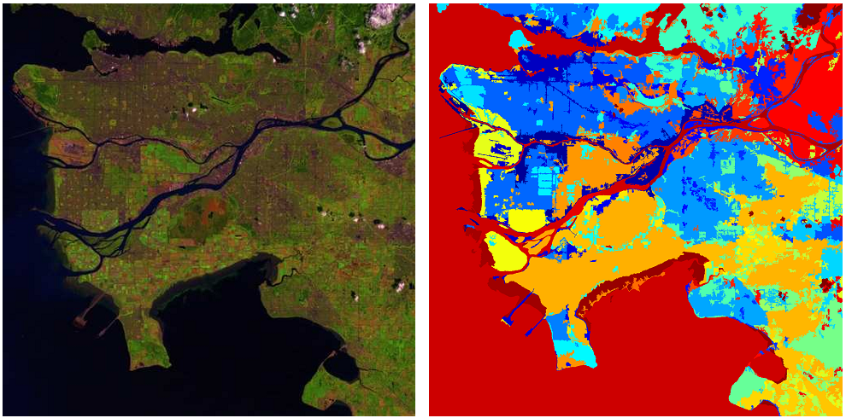
Labeled Images and Overlays
A satellite image and the corresponding labeled image after segmentation (displayed in pseudo-color).

Slide 6
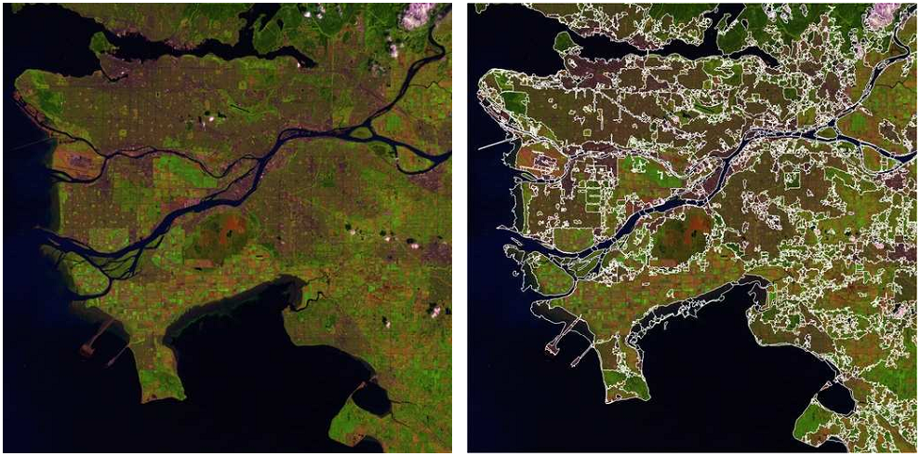
Labeled Images and Overlays
A satellite image and the corresponding segmentation overlay..

Slide 7
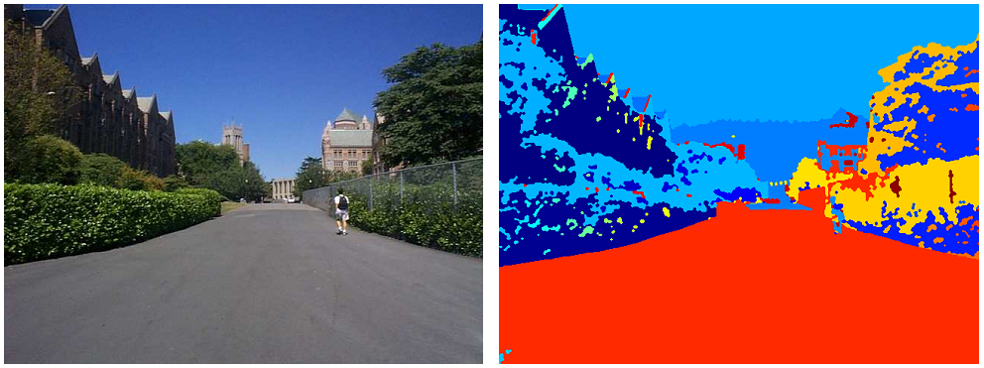
Labeled Images and Overlays
An image and the corresponding labeled image after segmentation
(displayed in pseudo-color).

Slide 8
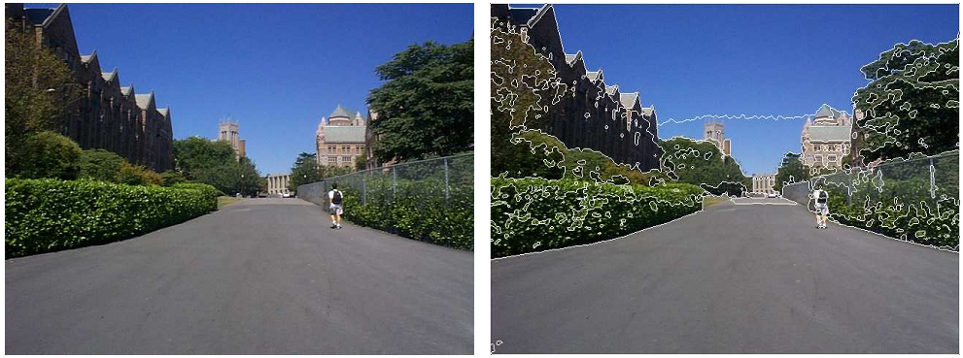
Labeled Images and Overlays
An image and the corresponding segmentation overlay.

Slide 9
Chain Codes
Regions can be represented by their boundaries in a data structure instead of an image.
The simplest form is just a linear list of the boundary points of each region.
This method generally is unacceptable because:
The resulting list tends to be quite long.
Any small disturbances along the boundary cause changes in the list that may not be related to the shape of the boundary.
A variation of the list of points is the chain code, which encodes the information from the list of points at any desired quantization.

Slide 10
Chain Codes
Conceptually, a boundary to be encoded is overlaid on a square grid whose side length determines the resolution of the encoding.
Starting at the beginning of the curve, the grid intersection points that come closest to it are used to define small line segments that join each grid point to one of its neighbors.
The directions of these line segments are then encoded as small integers from zero to the number of neighbors used in encoding.

Slide 11
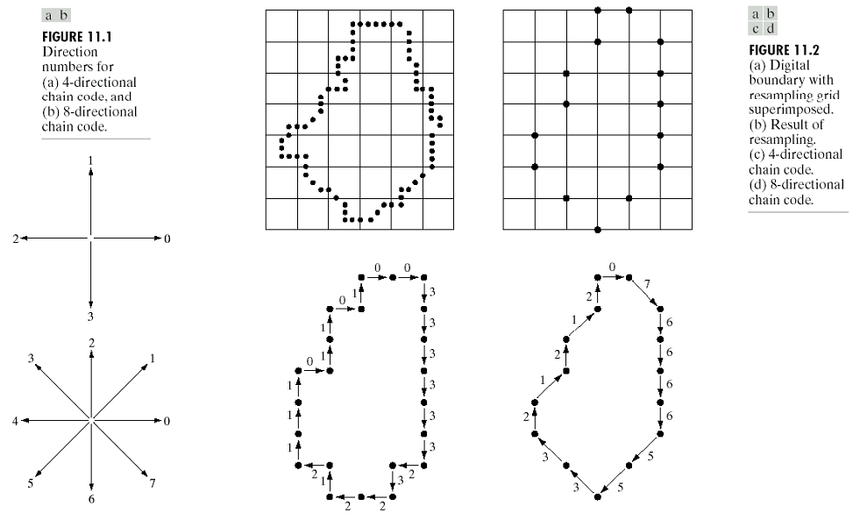
Chain Codes

Slide 12
Chain Codes
The chain code of a boundary depends on the starting point.
However, the code can be normalized by treating it as a circular sequence.
Size (scale) normalization can be achieved by altering the size of the sampling grid.
Rotation normalization can be achieved by using the first difference of the chain code instead of the code itself.
Count the number of direction changes (in counter-clockwise direction) that separate two adjacent elements of the code (e.g., 10103322→ 3133030).

Slide 13
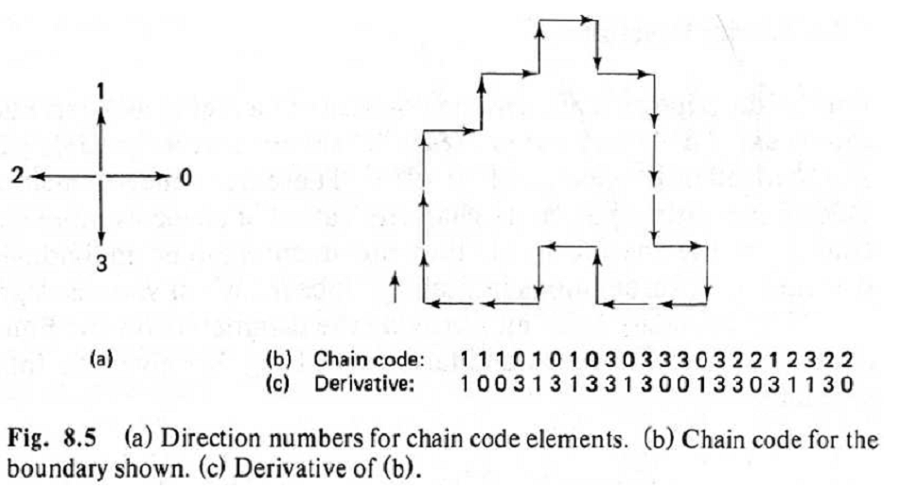
Chain Codes

Slide 14
Polygonal Approximations
When the boundary does not have to be exact, the boundary pixels can be approximated by straight line segments, forming a polygonal approximation to the boundary.
The goal of polygonal approximations is to capture the “essence” of the boundary shape with the fewest possible polygonal segments.
This representation can save space and simplify algorithms that process the boundary.

Slide 15
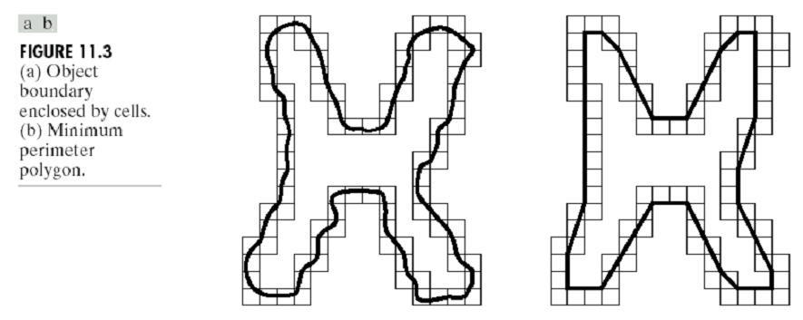
Polygonal Approximations
Minimum perimeter polygons:
Enclose the boundary by a set of concatenated cells.
Produce a polygon of minimum perimeter that fits the geometry established by the cell strip.

Slide 16
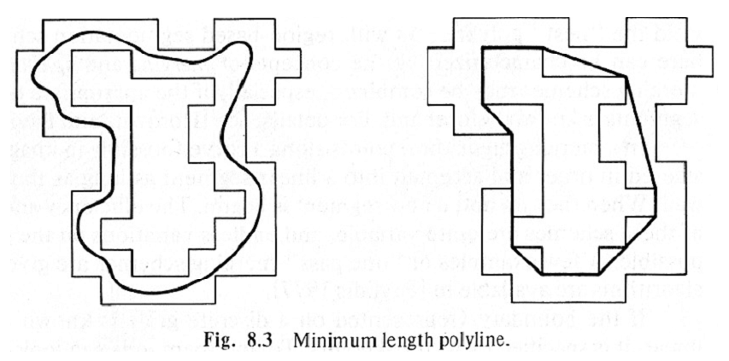
Polygonal Approximations

Slide 17
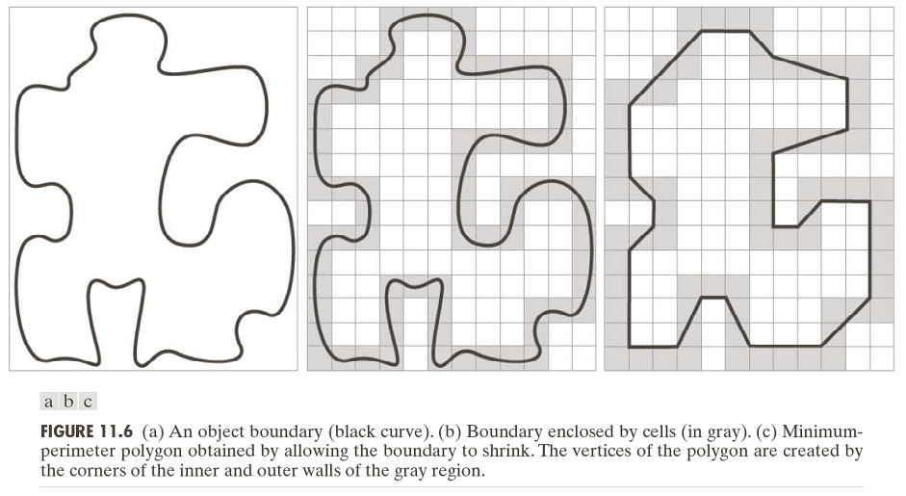
Polygonal Approximations

Slide 18
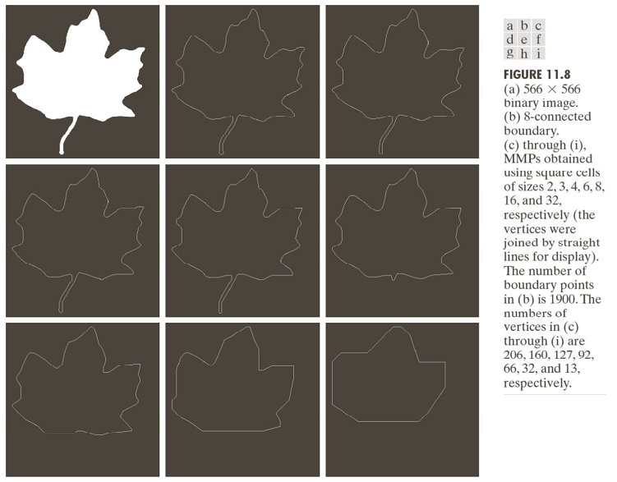
Polygonal Approximations

Slide 19
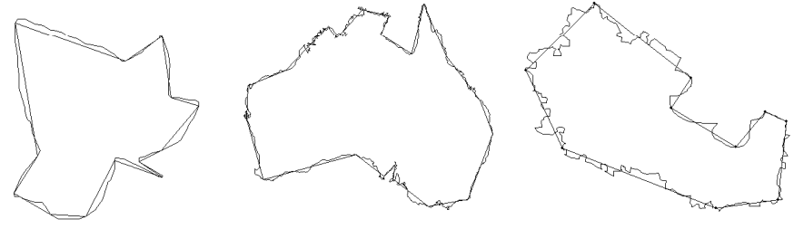
Polygonal Approximations
Merging techniques:
Points along a boundary can be merged until the least square error line fit of the points merged so far exceeds a preset threshold.
At the end of the procedure, the intersections of adjacent line segments form the vertices of the polygon.

Slide 20
Polygonal Approximations
Splitting techniques:
One approach is to subdivide a segment successively into two parts until a specified criterion is satisfied.
For instance, a requirement might be that the maximum perpendicular distance from a boundary segment to the line joining its two end points not exceed a preset threshold.
If it does, the farthest point from the line becomes a vertex, thus subdividing the initial segment into two.
The procedure terminates when no point in the new boundary segments has a perpendicular distances that exceeds the threshold.
Notes:
任何点的垂直距离超过阈值时，过程终止。

Slide 21
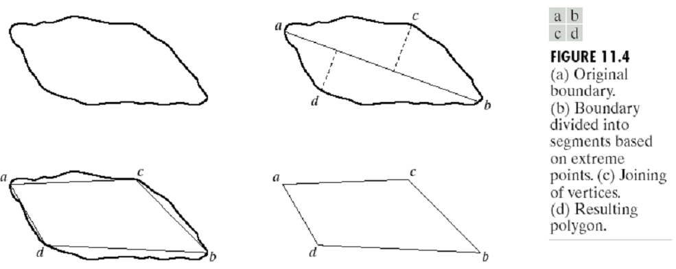
Polygonal Approximations

Slide 22
Scale Space
The scale space representation of a shape is created by tracking the position of inflection points on a shape boundary filtered by low-pass Gaussian filters of variable widths.
As the width (σ) of Gaussian filter increases, insignificant inflections are eliminated from the boundary and the shape becomes smoother.
The inflection points that remain present in the representation are expected to be “significant” object characteristics.

Slide 23
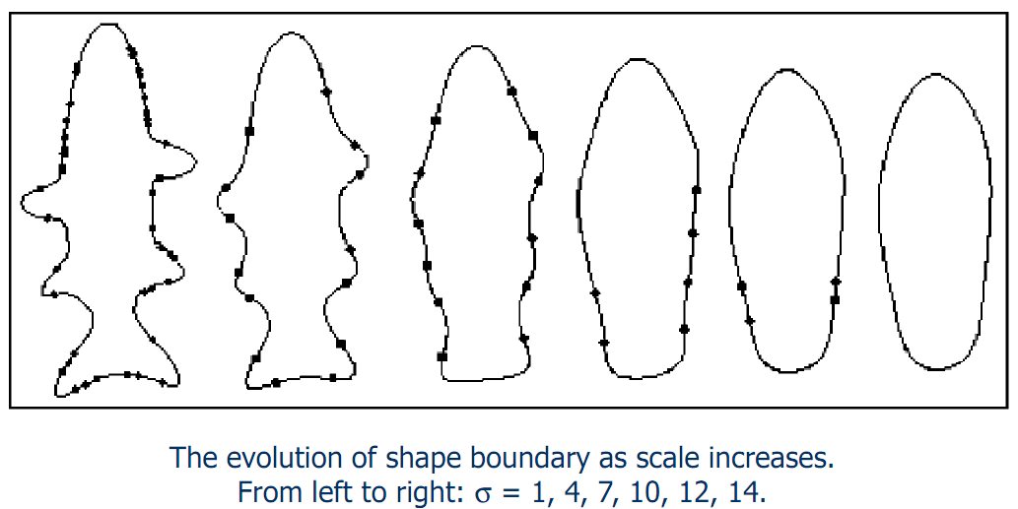
Scale Space

Slide 24
Signatures
A signature is a 1-D functional representation of a boundary.
A simple method is to plot the distance from the centroid to the boundary as a function of angle.
Normalization with respect to rotation and scaling are needed.
Another method is to traverse the boundary and, corresponding to each point on the boundary, plot the angle between the line tangent to the boundary at that point and a reference line.
A variation is to use the histogram of tangent angle values.

Slide 25
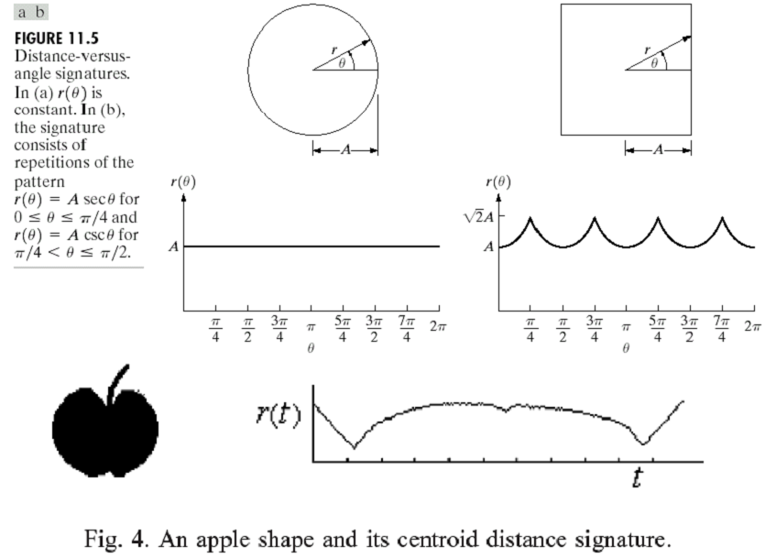
Signatures

Slide 26
Boundary Segments
Decomposing a boundary into segments can reduce the boundary’s complexity and simplify the description process.
The convex hull H of an arbitrary set S is the smallest convex set containing S.
The set difference H – S is called the convex deficiency of the set.
The region boundary can be partitioned by following the contour of S and marking the points at which a transition is made into and out of a component of the convex deficiency.

Slide 27
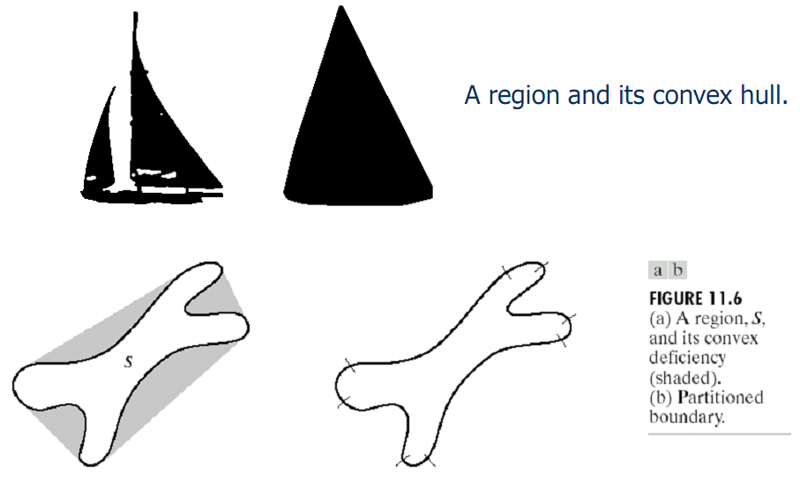
Boundary Segments

Slide 28
Skeletons
An important approach to representing the structural shape of a plane region is to reduce it to a graph.
This reduction may be accomplished by obtaining the skeleton of the region.
The medial axis transformation (MAT) can be used to compute the skeleton.
The MAT of a region R with border B is as follows:
For each point p in R, we find its closest neighbor in B.
If p has more than one such neighbor, it is said to belong to the medial axis of R.

Slide 29
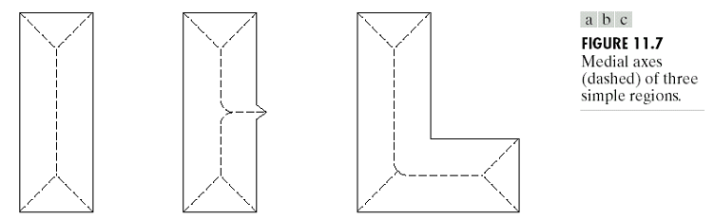
Skeletons
The MAT can be computed using thinning algorithms that iteratively delete edge points of a region subject to the constraints that deletion of these points
does not remove end points,
does not break connectivity, and
does not cause excessive erosion of the region.

Slide 30
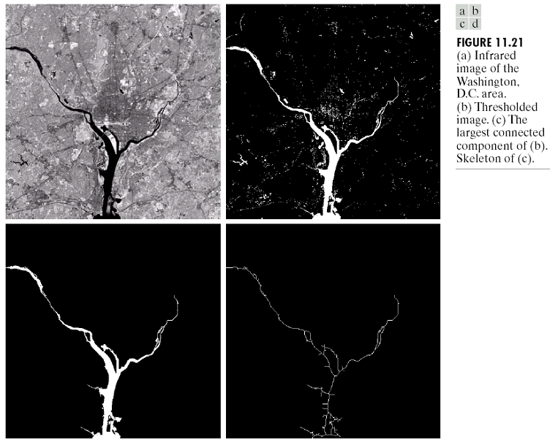
Skeletons

Slide 31
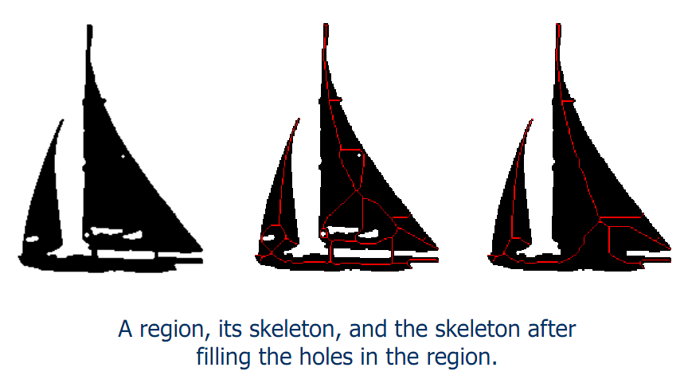
Skeletons

Slide 32
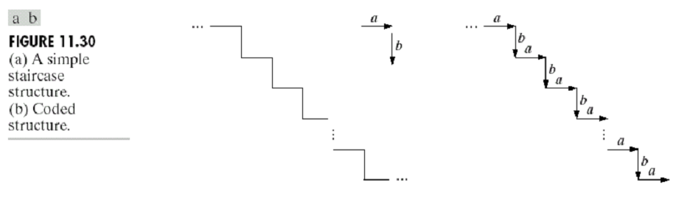
Relational Representations
Main purpose is to describe region boundaries using primitive elements.
Then, string-based representations of region boundaries can be obtained.

Slide 33
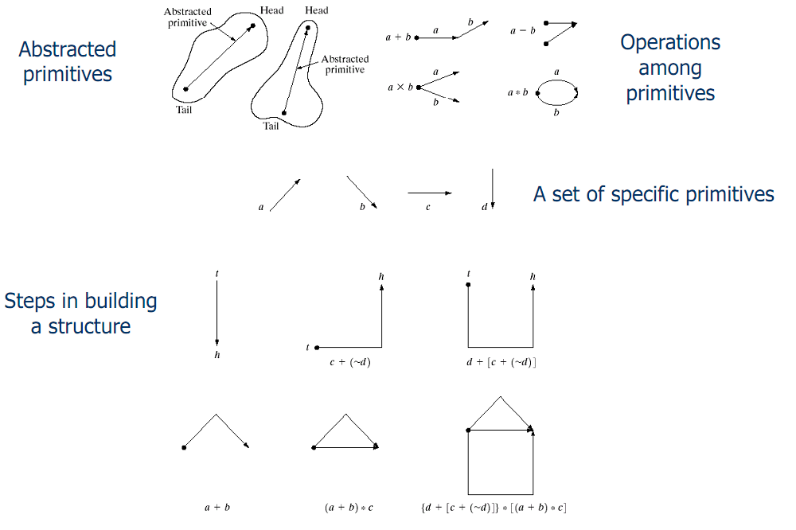
Relational Representations

Slide 34
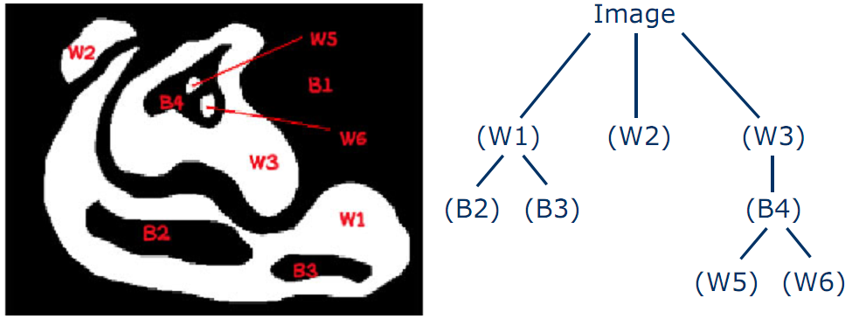
Composite Regions
Some regions can have holes and also multiple parts that are not contiguous..
A tree structure can be used to represent such regions.

Slide 35
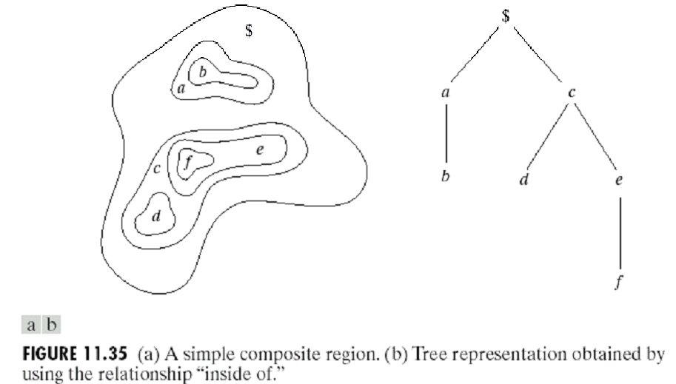
Composite Regions

Slide 36
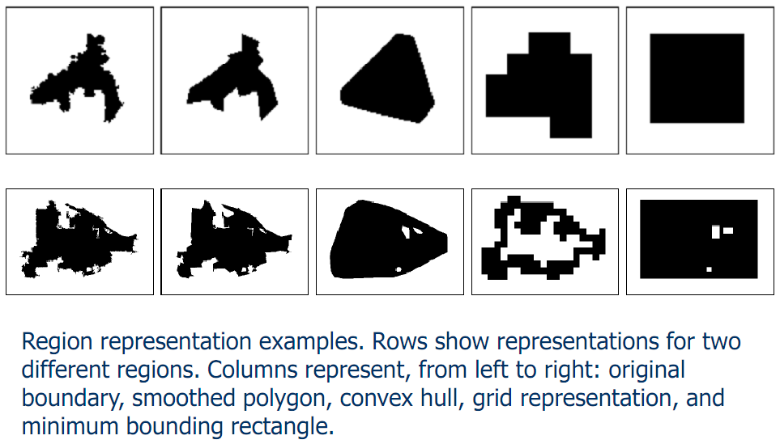
Examples

Slide 37
Region Descriptors
Boundary descriptors use external representations to model the shape characteristics of regions.
Regional descriptors use internal representations to model the internal content of regions.
Examples:
Shape properties (both internal and external)
Fourier descriptors (external)
Statistics and histograms (internal)

Slide 38
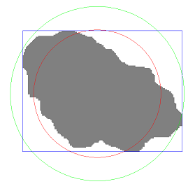
Shape Properties
Area
Number of pixels in the region
Perimeter
Number of pixels on the boundary
Number of vertical and horizontal components plus √2 times the number of diagonal components
Bounding box
Diameter
Maximum distance between
boundary points
Equivalent diameter
Diameter of a circle with the same area as the region

Slide 39
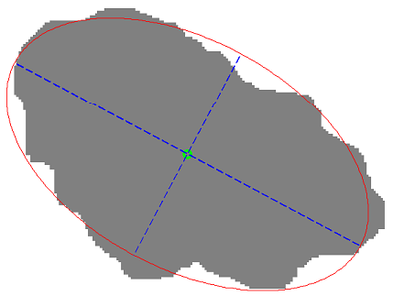
Shape Properties
Principal axes of inertia
Compute the mean of pixel coordinates (centroid)
Compute the covariance matrix of pixel coordinates
Major axis is the eigenvector of the covariance matrix corresponding to the larger eigenvalue
Minor axis is the eigenvector
of the covariance matrix
corresponding to the smaller
eigenvalue

Slide 40
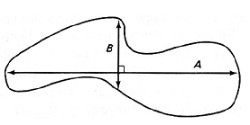
Shape Properties
Orientation
Compute the covariance matrix of pixel coordinates
Eccentricity (elongation)
Ratio of the length of maximum chord A
to maximum chord B perpendicular to A
Compactness
Perimeter² / area (minimized by a disk)
Extent
Area of region / area of its bounding box
Solidity
Area of region / area of its convex hull

Slide 41
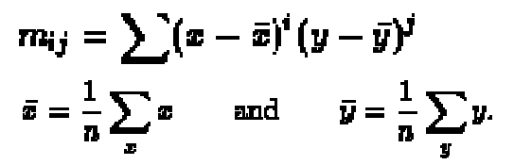
Shape Properties
Spatial variances
Variance of pixel coordinates along the principal axes of inertia
Euler number
Number of connected regions – number of holes (actually a topological property that describes the connectedness of a region, not its shape)
Moments

Slide 42
Fourier Descriptors
Given the list of K boundary points, start at an arbitrary point and traverse the boundary in a particular direction.
The coordinates can be expressed in the form x(k) = x_{k} and y(k) = y_{k} where k = 0, 1, …, K-1 shows the order of traversal.
Each coordinate pair can be treated as a complex number s(k) = x(k) + j y(k) for k = 0, 1, …, K-1.
The complex coefficients of the discrete Fourier transform of s(k) are called the Fourier descriptors of the boundary.

Slide 43
Fourier Descriptors
The inverse Fourier transform reconstructs s(k), i.e., the boundary.
If only the first P coefficients are used in the reconstruction, we obtain an approximation to the boundary.
Note that only P terms are used to obtain each component of s(k), but k still ranges from 0 to K-1.
Since the high-frequency components of the Fourier transform account for fine detail, the smaller P becomes, the more detail is lost on the boundary.

Slide 44
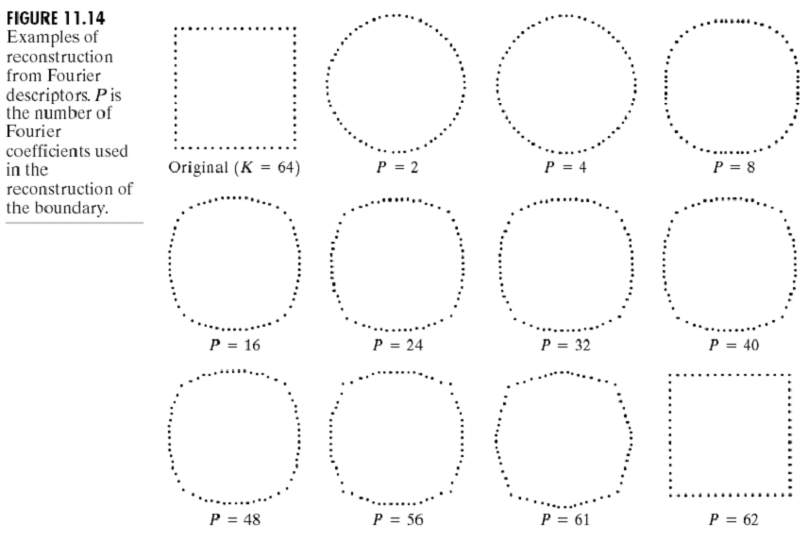
Fourier Descriptors

Slide 45
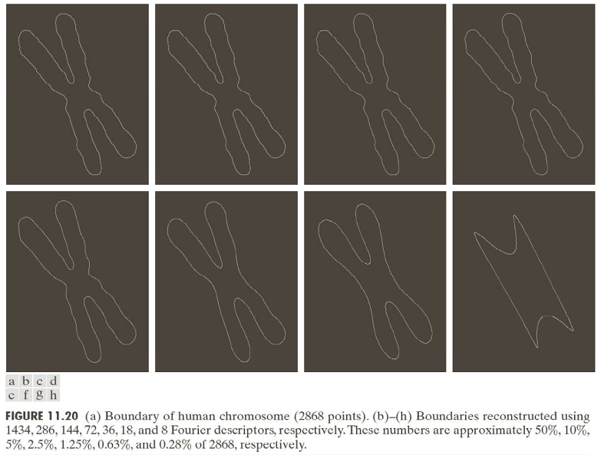
Fourier Descriptors

Slide 46
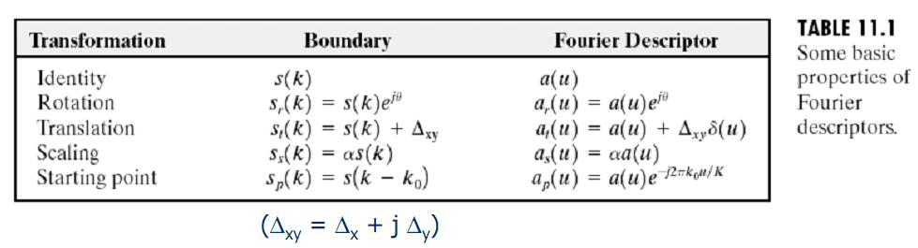
Fourier Descriptors
Fourier descriptors are not directly insensitive to geometrical changes such as translation, rotation and scale, but the changes in these parameters can be related to simple transformations on the descriptors.

Slide 47
Statistics and Histograms
Contents of regions can be summarized using statistics (e.g., mean, standard deviation) and histograms of pixel features.
Commonly used pixel features include
Gray tone,
Color (RGB, HSV, …),
Texture,
Motion.
Then, the resulting region level features can be used for clustering, retrieval, classification, etc.

Slide 48
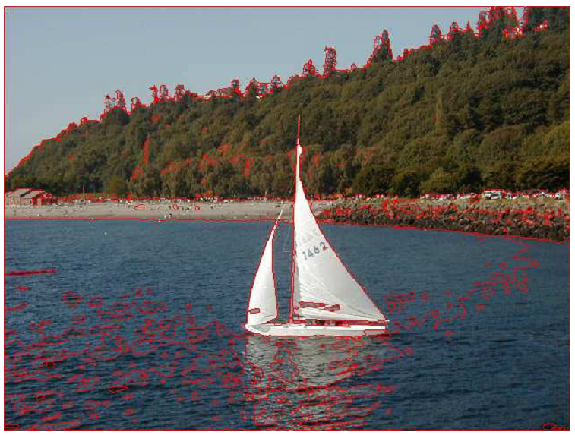
Statistics and Histograms

Slide 49
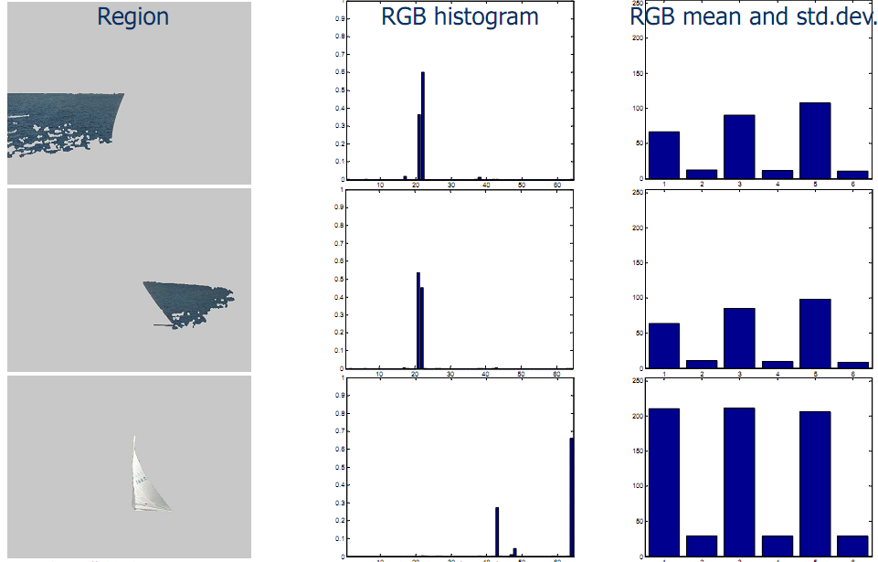
Statistics and Histograms

Slide 50
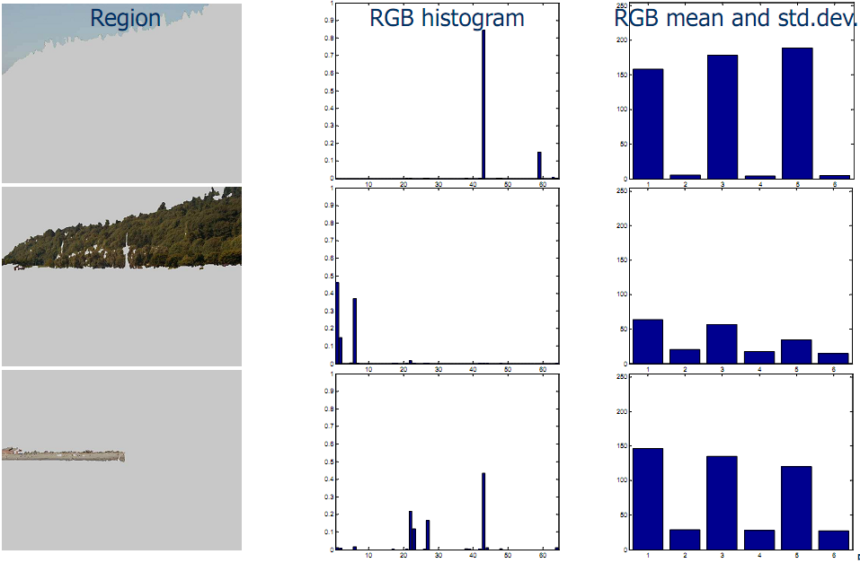
Statistics and Histograms

Slide 51
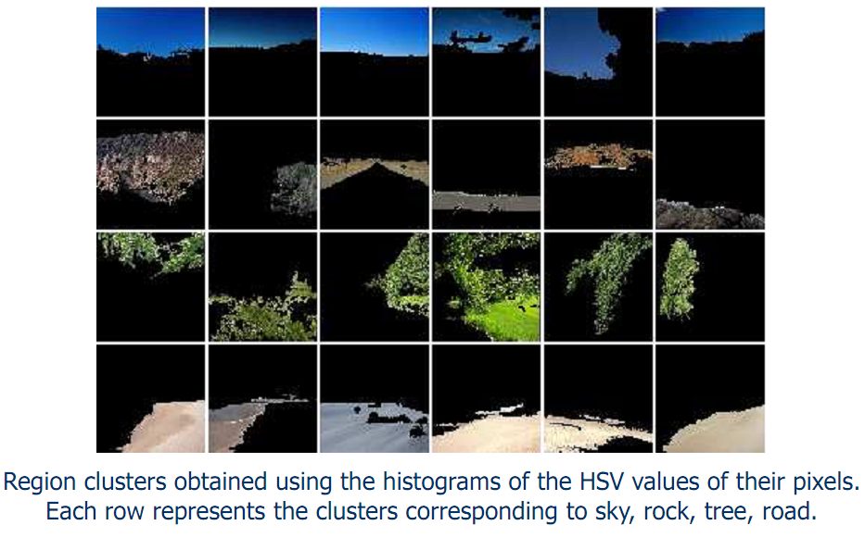
Statistics and Histograms

Slide 52
Image Representations and Descriptors
Popular image representations (in increasing order of complexity) include:
Gray tone,
Global representation
Tiled representations
Motion
Quadtrees
Region adjacency graphs
Attributed relational graphs

Slide 53
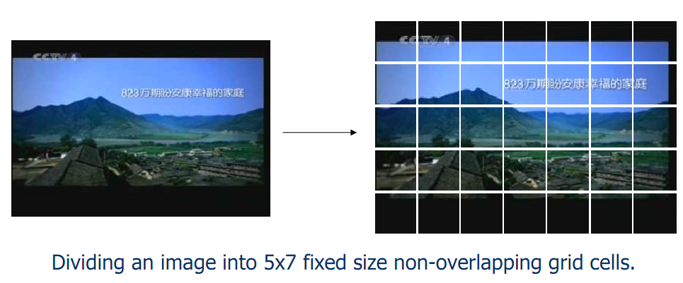
Tiled Representations
Images can be divided into fixed size or variable size grids that are overlapping or non-overlapping.

Slide 54
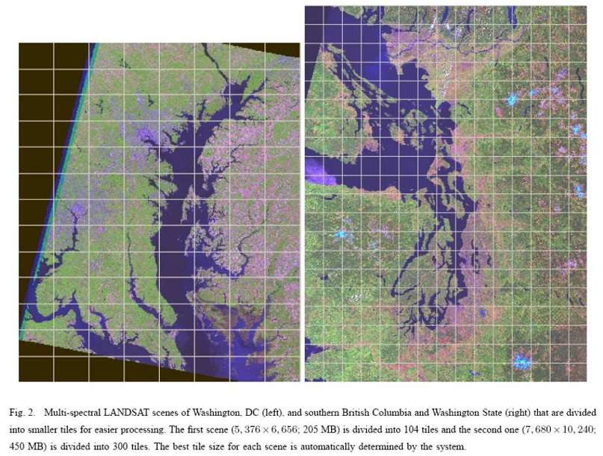
Tiled Representations

Slide 55
Quadtrees
Quadtrees:
Trees where nodes have 4 children.
Building a quadtree:
Nodes represent regions.
Every time a region is split, its node gives birth to 4 children.
Leaves are nodes for uniform regions.
Merging:
Siblings that are “similar” can be merged.

Slide 56
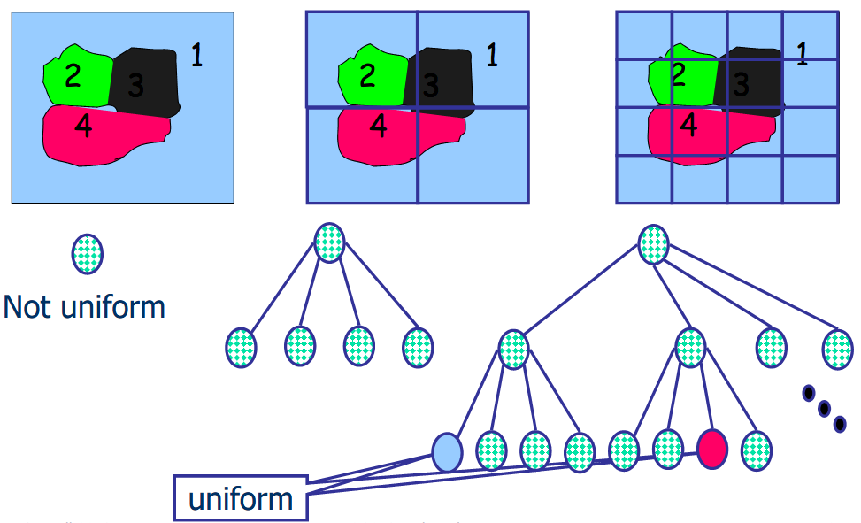
Quadtrees

Slide 57
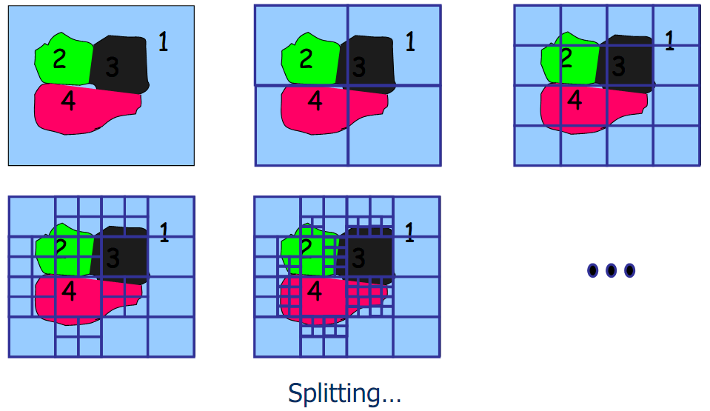
Quadtrees

Slide 58
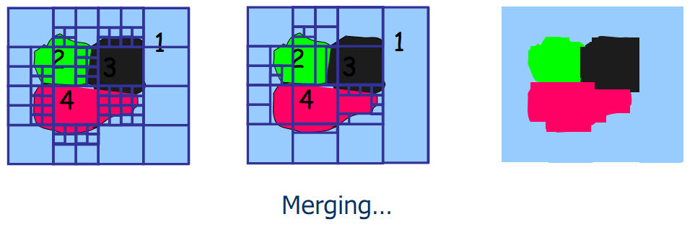
Quadtrees

Slide 59
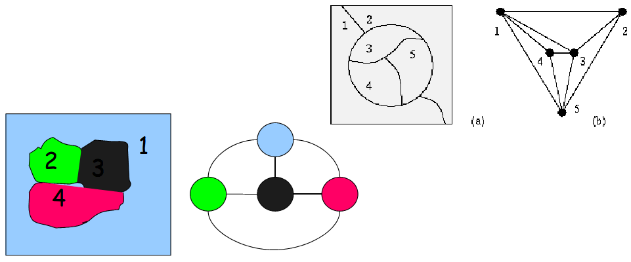
Region Adjacency Graphs
A region adjacency graph (RAG) is a graph in which each node represents a region of the image and an edge connects two nodes if the regions are adjacent.

Slide 60
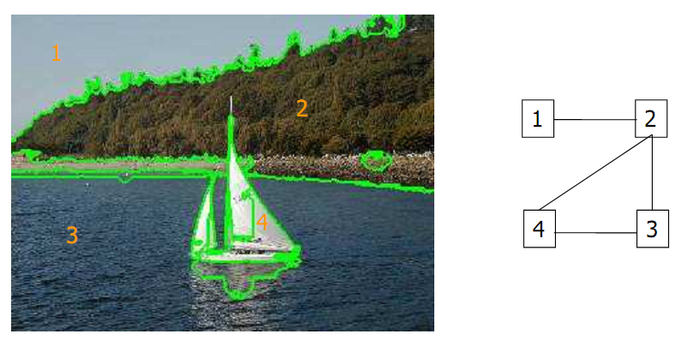
Region Adjacency Graphs

Slide 61
Attributed Relational Graphs
Attributed relational graphs (ARG) generalize ordinary graphs by attaching discrete or continuous features (attributes) to the vertices and edges.
Formally, an attributed relational graph G is a 4-tuple G=(N,E,µ,ν) where:
N is the set of nodes,
E ⊆ N ×N is the set of edges,
µ : N →LN is a function assigning labels to the nodes,
ν : E →LE is a function assigning labels to the edges.

Slide 62
Attributed Relational Graphs
Many real-world entities can be represented as an ARG.
For example, visual scenes can be modeled as the composition of the objects with specific spatial/attribute relationships.
Molecular compounds can be represented as an ARG with atoms as vertices and bonds as edges.
A web site can be represented as an ARG with web pages as vertices and URL links as edges.

Slide 63
Attributed Relational Graphs
Example application: modeling remote sensing image content using ARGs :
Nodes in the ARG represent the regions and edges represent the spatial relationships between these Regions.
Nodes are labeled with the class (land cover/use) names and the corresponding confidence values for these class assignments.
Edges are labeled with the spatial relationship classes and the corresponding degrees for these relationships.

Slide 64
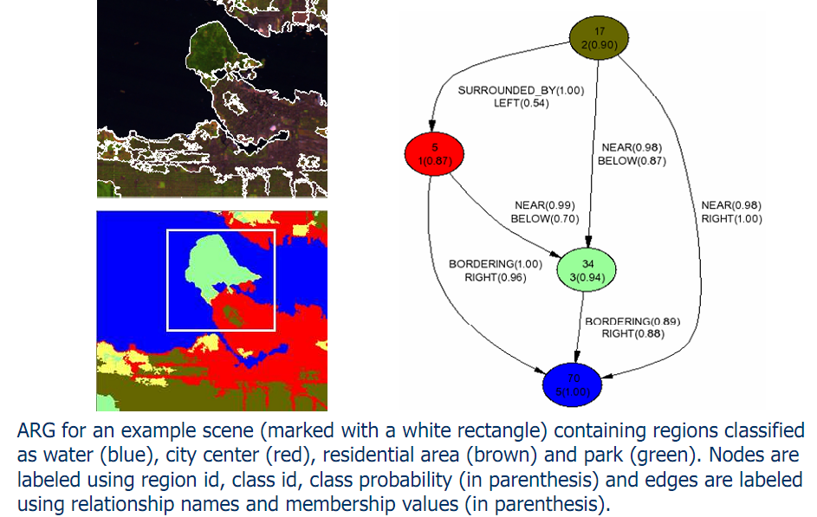
Attributed Relational Graphs

Slide 65
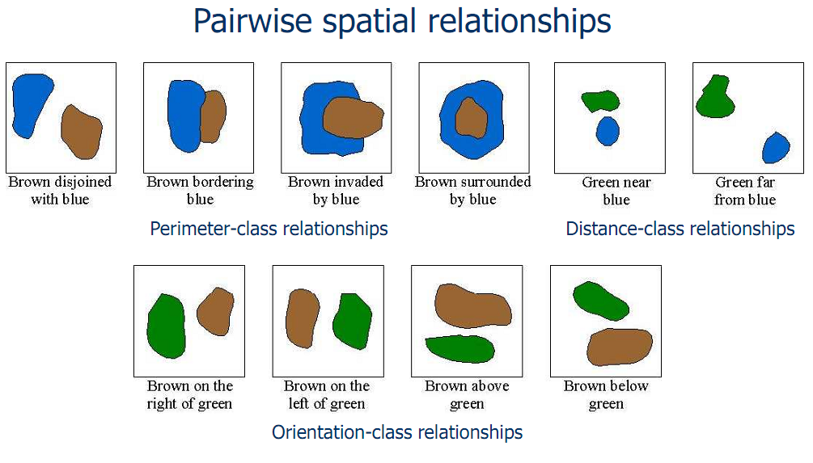
Attributed Relational Graphs

Slide 66
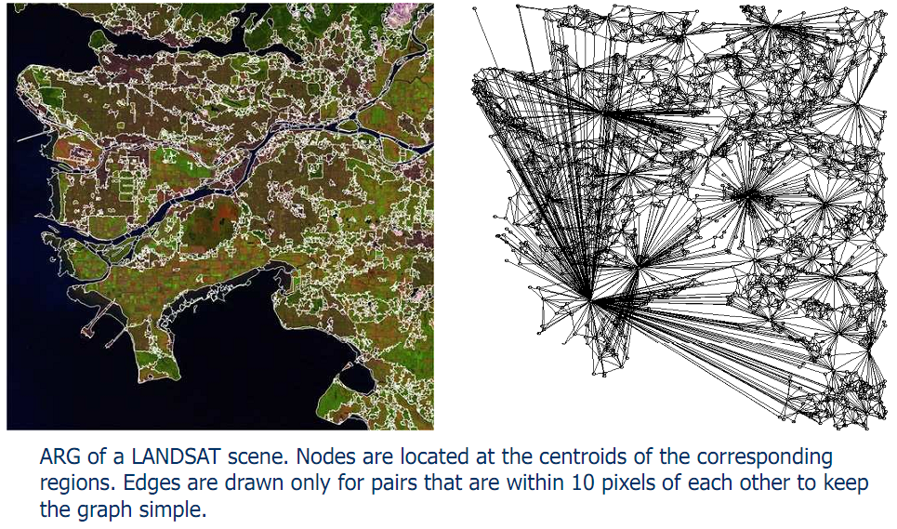
Attributed Relational Graphs

Slide 67
Attributed Relational Graphs
An important problem is how similarities between two scenes represented using ARGs can be found.
Relational matching has been extensively studied in structural pattern recognition.
One possible solution is the “editing distance” between two ARGs that is defined as the minimum cost taken over all sequences of operations (error corrections such as substitution, insertion and deletion) that transform one ARG to the other.

Slide 68
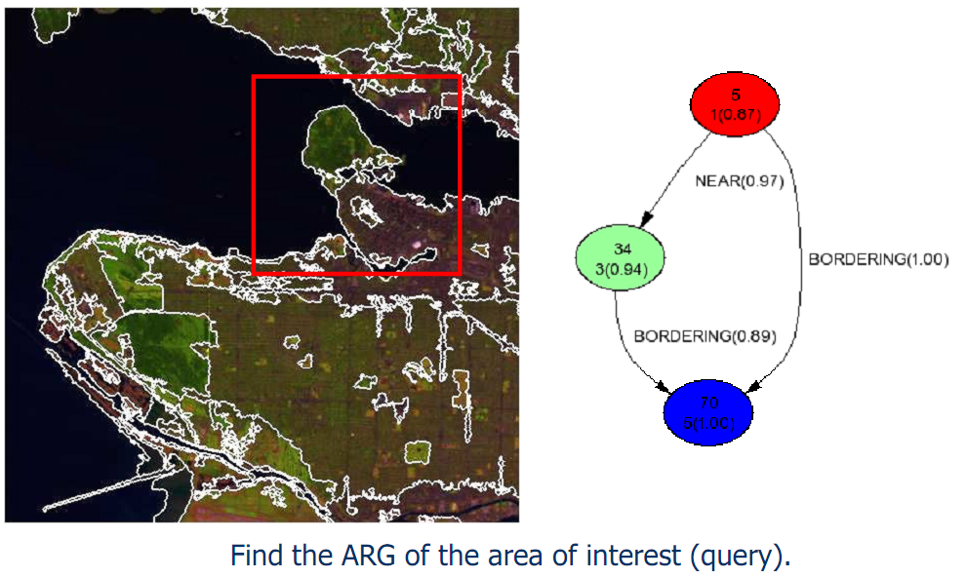
Attributed Relational Graphs

Slide 69
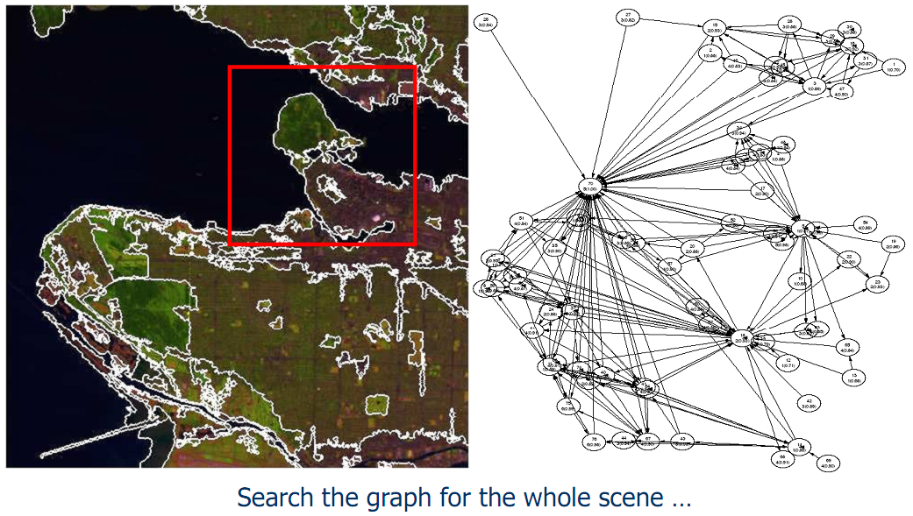
Attributed Relational Graphs

Slide 70
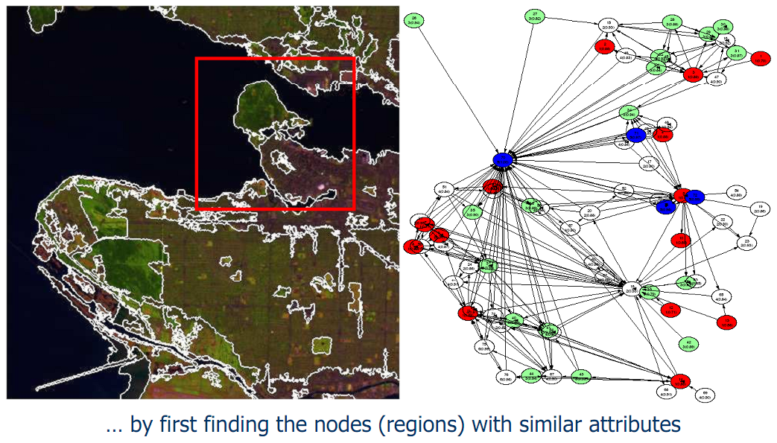
Attributed Relational Graphs

Slide 71
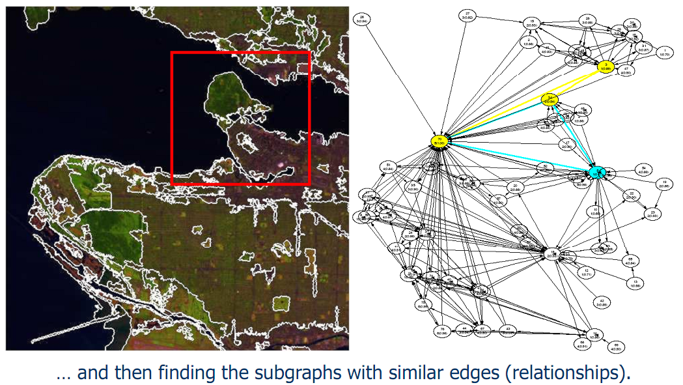
Attributed Relational Graphs

